Slide 1
Linux Fundamentals
Dr. Prashant Aparajeya

Slide 2
Learning Objectives:
Understand what Linux is and why it is widely used.
Become comfortable with the command-line interface (CLI) and basic navigation.
Learn the Linux file system hierarchy and file permissions.
Use package management (apt) to install, update, and manage software.
Master advanced CLI techniques such as piping, redirection, and text processing.
Monitor system resources and understand basic resource management commands.

Slide 3
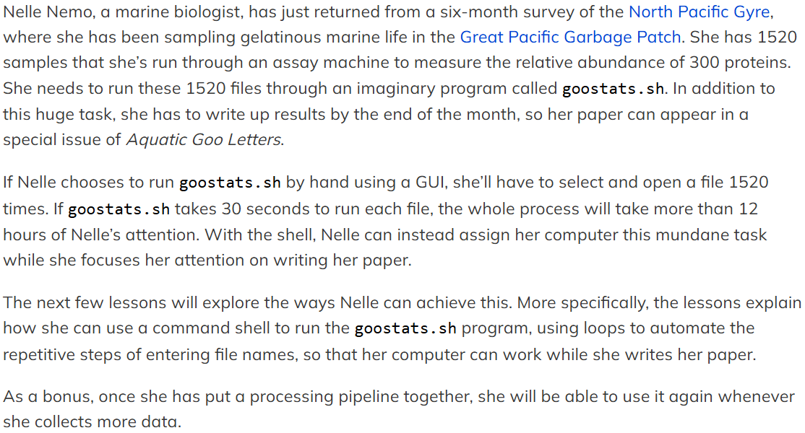
Story 1: A Marine Biologist

Slide 4
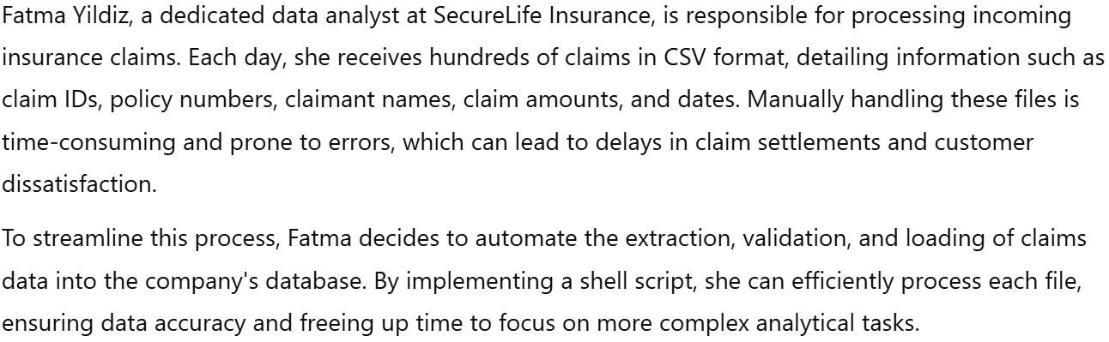
Story 2: An Insurance Company

Slide 5
Module 1: Introduction to Linux &
The Command Line

Slide 6
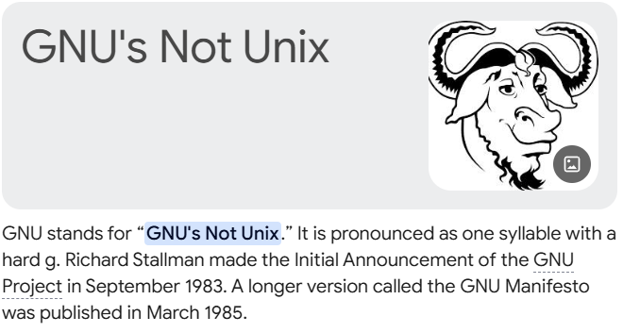
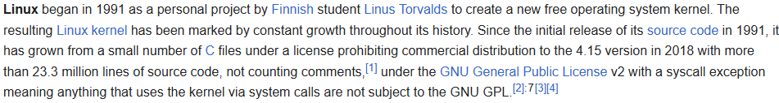

What is Linux?
Linux is an open-source, Unix-like operating system.
Key historical points:
Created by Linus Torvalds in 1991.
Combined with GNU utilities to form a complete OS.
Notes:
Linux is an open-source operating system that is based on Unix principles. It began with the release of the Linux kernel by Linus Torvalds in 1991 and grew into a full-fledged operating system when combined with the GNU tools (often collectively called GNU/Linux). This model emphasizes freedom, security, and flexibility.

Slide 7
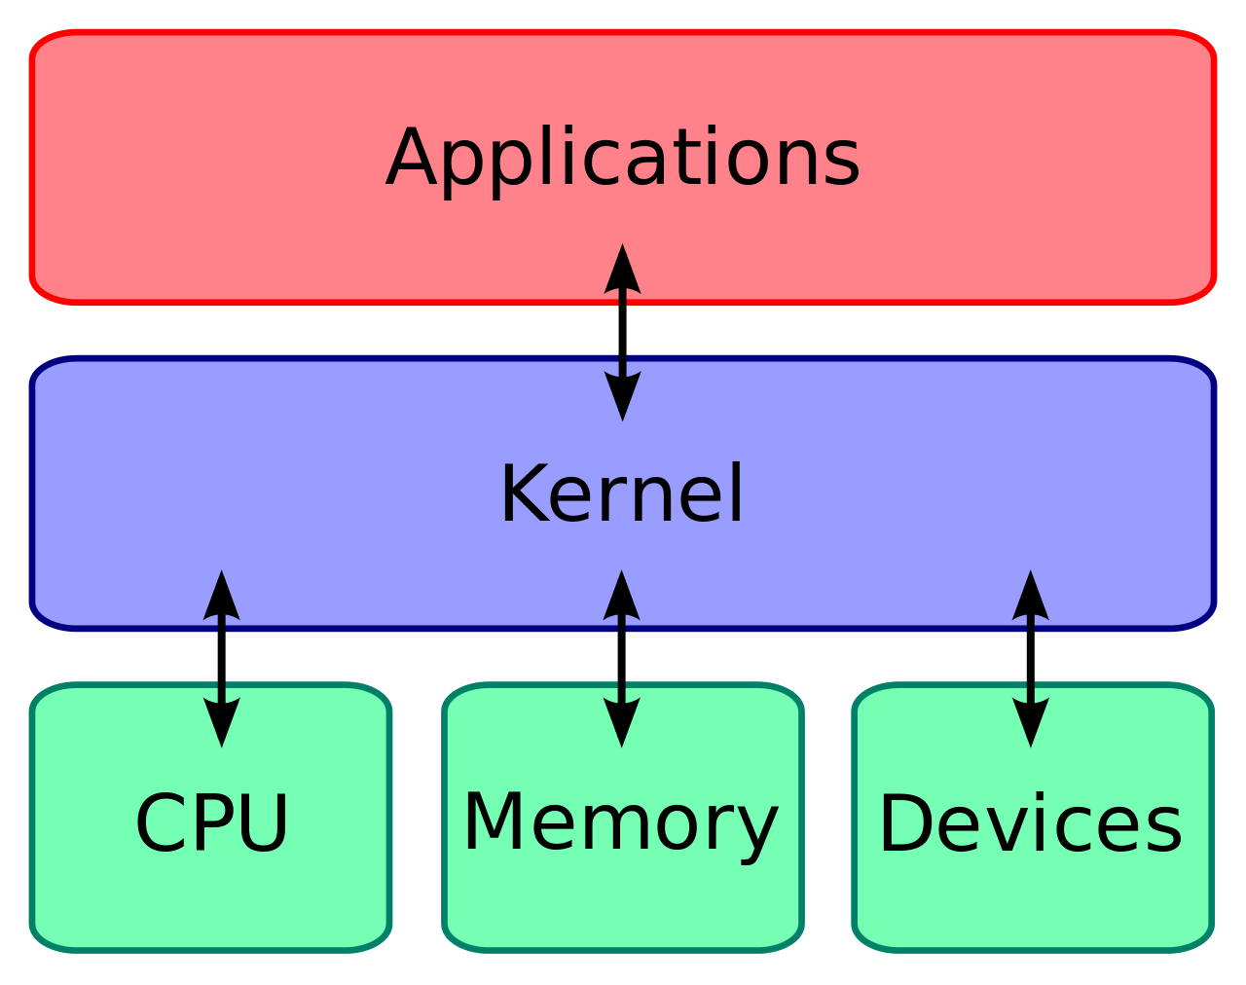

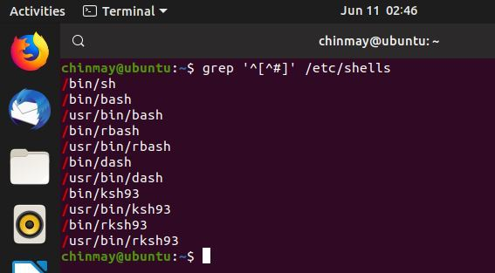
Linux Components
The Linux Kernel: the core that manages hardware.
GNU Utilities: the system programs and libraries.
The Shell: the command-line interpreter (e.g., Bash).
Graphical User Interface (GUI): optional layer on top of the OS.
Notes:
Kernel: The central part of the OS that manages hardware resources.
GNU Utilities: Essential software tools that provide user-level functions.
Shell: The program that accepts and executes user commands (commonly Bash).
GUI (Optional): A graphical layer that makes Linux user-friendly for those coming from a Windows or macOS background.

Slide 8
Why Use the Command Line?
Speed, automation, flexibility, and deeper control.
Real-world examples: system administration, development, scripting.
Unix/Linux is user-friendly—it's just picky about who its friends are.
"In the beginning was the command line, and with it, the power to create whole new worlds from nothing but lines of code."

Slide 9
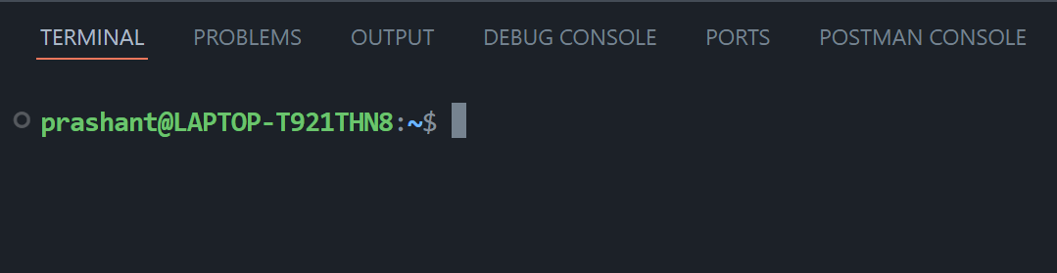
Opening a Terminal
How to launch the terminal in various environments:
Ubuntu: using the “Activities” search or keyboard shortcut (Ctrl+Alt+T).
Other Linux distributions and macOS (Terminal app) or Windows (WSL or Git Bash).
When the shell is first opened, you are presented with a prompt, indicating that the shell is waiting for input.

Slide 10
Basic Commands – Navigation
pwd: “Print Working Directory.”
cd: Change Directory.
Absolute path
Relative Path
ls: List directory contents (with options like -l,-F and -a).

Slide 11
Command Manuals
man command (e.g., man ls) to look up command details.
Alternatively, ls --help can do the same job on Linux and Git Bash.

Slide 12
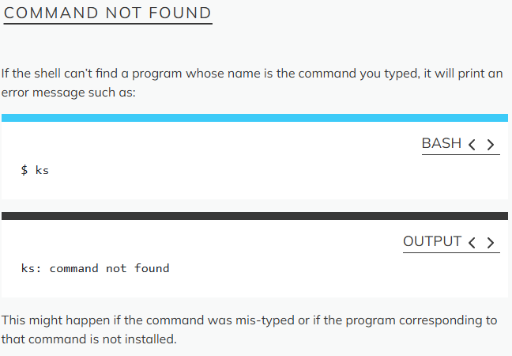
Troubleshooting
Command not found
Unsupported Command-Line Options (e.g. ls -j)
No such file or directory

Slide 13

FUN TIME
Launch the Terminal
Run the Basic Commands and Note the output:
pwd
ls
ls -l
ls -a
Can you produce some unsupported or invalid options for ls?
Generate an error: “No such file or directory”.
Explore for different ls options - Can you atleast identify 5 more options?

Slide 14
What did you learn in this Module?
Launching a terminal,
Navigating directories, and
Running a few basic commands

Slide 15
Key Points
The file system is responsible for managing information on the disk.
Information is stored in files, which are stored in directories (folders).
Directories can also store other directories, which then form a directory tree.
pwd prints the user’s current working directory.
ls [path] prints a listing of a specific file or directory; ls on its own lists the current working directory.
cd [path] changes the current working directory.
Most commands take options that begin with a single -.
Directory names in a path are separated with / on Unix, but \ on Windows.
/ on its own is the root directory of the whole file system.
An absolute path specifies a location from the root of the file system.
A relative path specifies a location starting from the current location.
. on its own means ‘the current directory’; .. means ‘the directory above the current one’.

Slide 16
Module 2: Navigating the Linux File System and Basic File Operations

Slide 17
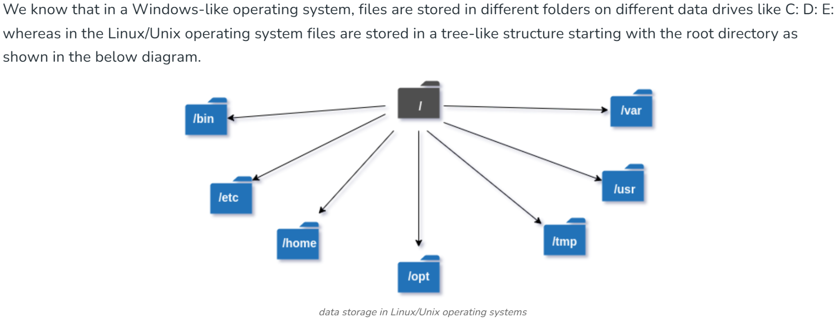
Understanding the Linux File System Hierarchy

Slide 18
Root (/) Directory
The root directory (/) is the highest level directory in a file system hierarchy, serving as the starting point from which all other files and directories branch out.
Importance of the Root Directory:
Central Hub: The root directory functions as the central hub of the entire filesystem, providing access to every file and subdirectory.
Hierarchical Organization: It enables a systematic organization of files and directories, facilitating efficient data management and easy file location.
Path Resolution: All file and directory paths begin from the root, allowing for unique identification and minimizing naming conflicts.
System Resources: Critical system files and applications are often stored in directories directly under the root, such as /bin for binaries and /etc for configuration files.
Starting Point for Navigation: The root directory serves as the initial gateway for users and search engines to navigate the file system or website structure.

Slide 19
Overview of essential directories
/home: User home directories.
/etc: Configuration files.
/var: Variable data like logs.
/usr: User programs and shared resources.
/tmp: Temporary files.

Slide 20
Absolute Paths
An absolute path is a complete file or directory location in a file system, starting from the root directory and including all subdirectories leading to the specific file or folder.
The key characteristics of an absolute path are:
It starts from the root directory (/)
It provides the full, unambiguous location of a file or directory
It remains the same regardless of the current working directory
It includes all directories in the hierarchy from root to the target
Example: "/home/user/documents/file.txt"

Slide 21
Relative Paths
A relative path is a way to specify the location of a file or directory in relation to the current working directory.
Unlike an absolute path, a relative path does not start from the root directory and does not include the full path from the beginning of the file system hierarchy.
Key characteristics of relative paths include:
They are based on the current working directory.
They do not start with a root directory symbol (/ in Unix-like systems or a drive letter in Windows).
They are typically shorter than absolute paths.
They can use special notations like "./" for the current directory and "../" for the parent directory.
Example: “../documents/file.txt”
Relative paths are commonly used in programming and web development for easier portability of code across different environments.
They are particularly useful when working within a specific directory or subdirectory, as they allow for more concise file references.

Slide 22
Some cd options
$ cd - Toggles between last and present directory locations.
Now Try these options:
$ cd .
$ cd /
$ cd /home/{user_name}
$ cd ../..
$ cd ~
$ cd home
$ cd ~/data/..
$ cd
$ cd ..

Slide 23
Symbols
/ : Root directory.
~ : Current user’s home directory.
. : Current directory.
.. : Parent directory.

Slide 24
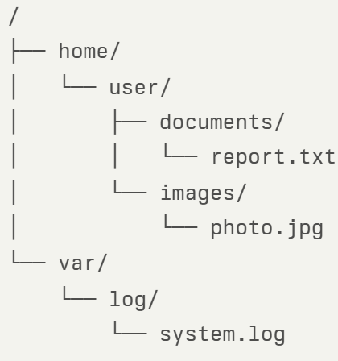
Example
Absolute Paths
Absolute paths always start from the root directory (/):
/home/user/documents/report.txt
/home/user/images/photo.jpg
/var/log/system.log
Relative Paths
Relative paths depend on the current working directory. Assuming we're in /home/user:
documents/report.txt
images/photo.jpg
../var/log/system.log
The ".." notation means "go up one directory level".

Slide 25
File Types & Hidden Files
Symbolic Links
Symbolic links, also known as soft links, are special files that act as pointers to other files or directories. They:
Contain a path to the target file or directory
Can link to files or directories on different file systems
Are denoted by an "l" in the first character of the file permissions when using ls -l
Regular Files
Regular files are the most common type of files in a file system. They contain data, such as text, images, or program code. Regular files:
Store actual data content
Can be read, written, or executed depending on permissions
Are typically created and modified by users or applications
Hidden Files
Hidden files in Unix-like systems are easily recognizable:
Their names start with a dot "." (e.g., .bashrc, .config)
They are not displayed by default when using the ls command
To view hidden files, use ls -a or ls -la in the terminal
Hidden files are often used for storing user-specific configuration data

Slide 26
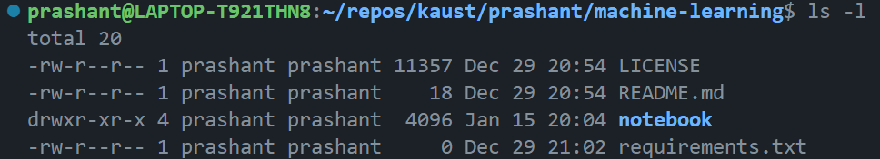
Basic Permissions Overview
File permissions in Unix-like systems control access to files and directories. The basic permission types are:
Read (r): Allows viewing file contents or listing directory contents
Write (w): Permits modifying or deleting files, or creating/deleting files within a directory
Execute (x): Enables running executable files or accessing directory contents
Permissions are assigned to three categories of users:
Owner (u): The user who owns the file
Group (g): Members of the file's group
Others (o): All other users on the system
Permissions can be viewed using the ls -l command, which displays them in symbolic notation (e.g., rwxr-xr-x) or numeric notation (e.g., 755).

Slide 27
Create, Copy, Rename Directories
mkdir Command
The mkdir (make directory) command is used to create new directories. Its basic syntax is:
mkdir [options] directory_name
Examples:
Create a directory in the current location: mkdir new_folder
Create a directory using an absolute path: mkdir /home/user/documents/project_folder
Create multiple directories at once: mkdir folder1 folder2 folder3
Create parent directories if they don't exist: mkdir -p /path/to/new/nested/directory
Set Directory Permissions mkdir -m 700 <directory>
Verbose Mode mkdir -v <directories>
Copy a Directory:
$ cp -r <source_dir> <dest_dir> Rename a Directory:
$ mv <old_name> <new_name>

Slide 28
Removing Directories
rmdir Command
The rmdir (remove directory) command is used to delete new directories. Its basic syntax is:
rmdir [options] directory_name
Examples:
Remove an empty directory: rmdir empty_folder
Remove a directory using an absolute path: rmdir /home/user/documents/old_project
Remove parent directories if they become empty: rmdir -p /path/to/empty/nested/directory
Add safety with Prompts – Use the ‘- i’ option to confirm each deletion: rm -ri <directory_to_delete>

Slide 29
Caution with Removing Directories
rmdir only removes empty directories. If a directory contains files or subdirectories, rmdir will fail.
For non-empty directories, the rm command with the -r (recursive) option can be used, but this should be done with extreme caution: rm -r directory_name
Always double-check the directory path before removing it, especially when using absolute paths or the recursive option.
Consider using the -i (interactive) option with rm to prompt for confirmation before each deletion.
Be particularly careful when removing directories with sudo privileges, as this can potentially damage your system if used incorrectly.
Remember, it's always a good practice to backup important data before performing operations that could result in data loss.

Slide 30
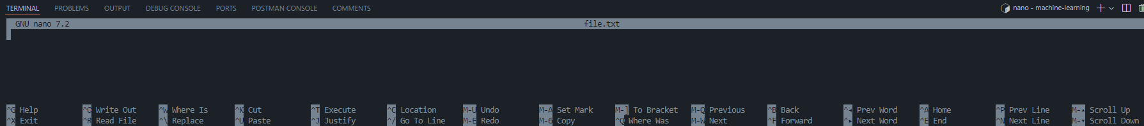
File Operations
Create a text File: $ touch file.txt Alternatively, you can use nano editor if nano is installed on the system: $ nano file.txt
Copy a File: $ cp <source_file> <destination_file> e.g.: $ cp file.txt copy_of_file.txt
Move a File: $ mv file.txt /path/to/destination/
Rename a File: $ mv file.txt new_file.txt
Delete a File: $ rm file.txt

Slide 31
Wildcards
* is a wildcard, which represents zero or more other characters. Let’s consider the shell-lesson-data/exercise-data/alkanes directory: *.pdb represents ethane.pdb, propane.pdb, and every file that ends with ‘.pdb’. On the other hand, p*.pdb only represents pentane.pdb and propane.pdb, because the ‘p’ at the front can only represent filenames that begin with the letter ‘p’.
? is also a wildcard, but it represents exactly one character. So ?ethane.pdb could represent methane.pdb whereas *ethane.pdb represents both ethane.pdb and methane.pdb.
Wildcards can be used in combination with each other. For example, ???ane.pdb indicates three characters followed by ane.pdb, giving cubane.pdb ethane.pdb octane.pdb.
When the shell sees a wildcard, it expands the wildcard to create a list of matching filenames before running the preceding command. As an exception, if a wildcard expression does not match any file, Bash will pass the expression as an argument to the command as it is. For example, typing ls *.pdf in the alkanes directory (which contains only files with names ending with .pdb) results in an error message that there is no file called *.pdf. However, generally commands like wc and ls see the lists of file names matching these expressions, but not the wildcards themselves. It is the shell, not the other programs, that expands the wildcards.

Slide 32
List Filenames Matching a Pattern
When run in the alkanes directory, which ls command(s) will produce this output?
ethane.pdb methane.pdb
ls *t*ane.pdb
ls *t?ne.*
ls *t??ne.pdb
ls ethane.*

Slide 33
FUN TIME
List the “root” directory
Check your current location
Move to a directory using an “absolute” path
Do these:
Change Directories:
Go to “home” directory,
Go to “root” directory
Change to the /temp directory
From the “root” directory:
List the contents of “home” directory
Then list the contents on a directory in the “home” directory
Then change to that directory.
Display hidden files
Create, Explore and then Remove a “test” directory

Slide 34
What did you learn in this Module?
How the Linux file system is organized,
Be comfortable navigating through directories,
Identifying hidden files, and
Performing basic file operations

Slide 35
Key Points
cp [old] [new] copies a file.
mkdir [path] creates a new directory.
mv [old] [new] moves (renames) a file or directory.
rm [path] removes (deletes) a file.
* matches zero or more characters in a filename, so *.txt matches all files ending in .txt.
? matches any single character in a filename, so ?.txt matches a.txt but not any.txt.
Use of the Control key may be described in many ways, including Ctrl-X, Control-X, and ^X.
The shell does not have a trash bin: once something is deleted, it’s really gone.
Most files’ names are something.extension. The extension isn’t required, and doesn’t guarantee anything, but is normally used to indicate the type of data in the file.
Depending on the type of work you do, you may need a more powerful text editor than Nano.

Slide 36
Module 3: Package Management with apt

Slide 37
Introduction to Package Management
Package management is a crucial process in software development that involves:
organizing,
controlling, and
distributing
software components essential for servers and applications

Slide 38
Introduction to Package Management
Package managers offer numerous benefits, including:
Control over software installation and removal
Visibility of installed packages
Security features like encryption and signing
Traceability of package versions and dependencies
Auditing capabilities for uploads and downloads

Slide 39
Introduction to Package Management
A software package is a bundle of various software components and configuration files combined into a single unit. It typically contains:
Executable files
Configuration files
Libraries
Scripts
Documentation
apt’s role:
Retrieves package information from repositories.
Handles installation, upgrade, and removal of packages.

Slide 40
Essential apt Commands
sudo apt update – Refresh package lists.
sudo apt upgrade – Upgrade installed packages.
sudo apt install <package> – Install a new package.
sudo apt remove <package> – Remove an installed package.
sudo apt autoremove – Remove orphaned dependencies.
apt-cache search <keyword> – Search for packages.
apt search <keyword> – can also be used on the newer version of apt.

Slide 41
Using sudo with apt
Administrative privileges (sudo) are required when using apt for several important reasons:
System-wide changes: apt operations often modify system files and directories that are not accessible to regular users.
Package integrity: sudo ensures that only authorized users can install, update, or remove software packages, maintaining system security and stability.
Protection of critical components: Many packages managed by apt are essential for system functionality, and sudo prevents accidental or unauthorized modifications.

Slide 42
Using sudo with apt
When using sudo with apt, consider these safety tips:
Double-check commands before execution to avoid unintended changes.
Use specific sudo privileges for package management rather than full root access.
Regularly update the system to patch security vulnerabilities.
Be cautious when using commands like apt full-upgrade, which can remove installed packages.
Configure sudo to log all activities for auditing purposes.

Slide 43
Remember, with great power comes great responsibility.
Always exercise caution when using sudo, as it grants elevated privileges that can significantly impact your system if misused.

Slide 44
Best Practices & Troubleshooting
Always run apt update before installing.
Read the output carefully to catch any errors.
When in doubt, check the manual pages (man apt).
Discuss common issues such as repository errors or dependency conflicts.
Regularly remove orphaned dependencies using sudo apt autoremove.

Slide 45
FUN TIME
Update Package Lists
Upgrade Installed Packages
Search for a Package - “apache2”
Package: “rolldice” or “tree” or “curl”
Install this Package
Verify the Installation
Remove the Package
Clear any dependencies that are no longer needed

Slide 46
FUN TIME
Update Package Lists sudo apt update
Upgrade Installed Packages sudo apt upgrade
Search for a Package - “curl” apt search curl
Package: “rolldice” or “tree” or “curl”
sudo apt install curl
curl --version
sudo apt remove curl
sudo apt autoremove

Slide 47
What did you learn in this Module?
manage software on the Linux system,
understand how dependencies are resolved, and
appreciate best practices for maintaining a secure and updated system

Slide 48
Module 4: Advanced Command-Line Operations

Slide 49
Advanced Command-Line Operations
Master input/output redirection techniques
Utilize pipes to combine multiple commands effectively
Employ grep for powerful text searching and pattern matching
Leverage sed for efficient text manipulation and substitution
Harness the power of awk for advanced text processing and data extraction

Slide 50
Understanding Standard Streams
Standard streams are fundamental input/output communication channels in Unix-like operating systems, including Linux. There are three standard streams:
stdin (Standard Input, file descriptor 0): The input stream that provides data to commands.
stdout (Standard Output, file descriptor 1): The output stream where commands send their normal output.
stderr (Standard Error, file descriptor 2): The output stream for error messages and diagnostics.

Slide 51
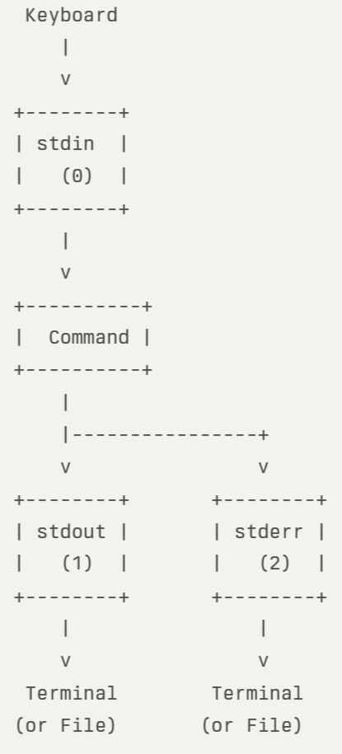
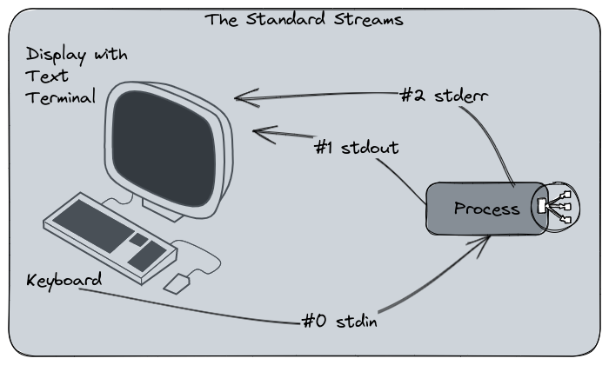
In this diagram:
stdin (0) receives input from the keyboard by default.
The command processes the input and generates output.
stdout (1) sends normal output to the terminal or a file.
stderr (2) sends error messages to the terminal or a file.
By default, both stdout and stderr display their output on the terminal. However, these streams can be redirected to files or other commands using redirection operators (>, <, 2>) or pipes (|)
Example:
$ ls > filelist.txt # Redirect stdout to a file $ ls 2> error.log # Redirect stderr to a file

Slide 52
Redirection Operators
Basic redirection:
> : Overwrite a file with command output. $ echo "Hello, world!" > greeting.txt
>>: Append command output to an existing file. $ echo "How are you?" >> greeting.txt
< : Use a file as input to a command. $ sort < unsorted_list.txt
Special redirection:
2>&1: Merge stderr with stdout. This redirects stderr (file descriptor 2) to the same destination as stdout (file descriptor 1): $ command > output.txt 2>&1
Example: find / -name "*.txt" > found_files.txt 2>&1

Slide 53
Some Important Commands to Play with
$ wc <file_name> “word count” command to count the number of lines, words, and characters in files
$ wc *.txt
$ wc -l *.txt only number of lines are returned
$ wc -l *.txt > lengths.txt in the write mode it prints the output into lengths.txt (you can change this name)
$ cat lengths.txt concatenates together the file content and prints the contents of the files one after another.
$ less lengths.txt displays a screenful of the file, and then stops. Go forward - “space” backward - “b” quit - “q”
$ sort -n lengths.txt sorts the contents of the file (line wise operation)
-n : numerical sorting
$ sort -n lengths.txt > sorted-lengths.txt
$ head -n 1 sorted-lengths.txt tells it that we only want the first line of the file; -n 20 would get the first 20.
$ head -n 3 animals.csv > animals-subset.csv
$ tail -n 2 animals.csv >> animals-subset.csv
$ cut -d , -f 2 animals.csv used to remove or ‘cut-out’ certain sections of each line in the file -d delimiter for field delimiter -f select only these fields; also print any line that contains no delimiter character, unless the -s option is specified

Slide 54
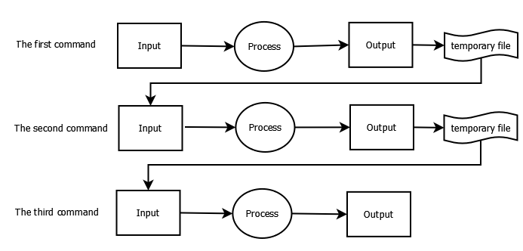
Introduction to Piping
The pipe operator (|) in Linux is a powerful tool that allows you to chain multiple commands together by feeding the output of one command as input to the next. This enables the creation of complex command sequences and efficient data processing on the command line.
Examples: $ ls | grep '.txt' | wc -l $ cat logfile.txt | grep "ERROR" | wc -l $ sort -n lengths.txt | head -n 1 $ wc -l *.txt | sort -n $ wc -l *.txt | sort -n | head -n 1 $ cat animals.csv | head -n 5 | tail -n 3 | sort -r > final.txt

Slide 55
Text Processing with grep
grep is a powerful command-line utility for searching and filtering text based on patterns. It's an essential tool for text processing in Unix-like operating systems.
grep searches input files for lines containing a match to a given pattern. Its basic syntax is: $ grep [options] pattern [file...]
Key features of grep include:
Pattern matching using regular expressions
Filtering lines from files or command output
Displaying matching lines or file names

Slide 56
Common grep Options
-i (ignore case): Performs case-insensitive matching $ grep -i "gnu" GPL-3 This command finds all occurrences of "gnu", "GNU", "Gnu", etc. in the GPL-3 file.
-r (recursive search): Searches files in the current directory and all subdirectories $ grep -r "pattern" /path/to/directory
-v (invert match): Displays lines that do not match the pattern $ grep -v "string" file.txt This returns all lines that do not contain "string".
-n (line number): Displays the line number along with the matching lines $ grep -n "pattern" file.txt
-l (files with matches): Shows only the names of files containing matches $ grep -l "pattern" *
-c (count): Displays the count of matching lines instead of the lines themselves $ grep -c "pattern" file.txt
grep is highly versatile and can be combined with other commands using pipes (|) for complex text processing tasks. For example:
$ ls | grep ".txt" | wc -l

Slide 57
Using sed for Stream Editing
sed (stream editor) is a powerful command-line utility for text processing in Unix-like operating systems. It's particularly useful for substitution and deletion operations on text streams or files.

Slide 58
Substitution with sed
The basic syntax for substitution in sed is:
sed 's/pattern/replacement/flags'
To substitute "error" with "warning" globally in a file:
sed 's/error/warning/g' input_file.txt
This command reads input_file.txt, replaces all occurrences of "error" with "warning", and outputs the result to the terminal. The 'g' flag ensures all matches on each line are replaced.

Slide 59
Deletion with sed
To delete lines matching a pattern:
sed '/pattern/d' input_file.txt
For example, to delete all lines containing "error":
sed '/error/d' input_file.txt

Slide 60
Key Features of sed
In-place editing: Use the -i option to edit files directly.
Multiple commands: Combine commands using semicolons or -e option.
Regular expressions: Utilize powerful pattern matching.
Address ranges: Apply commands to specific line ranges.
sed is particularly efficient for processing large files or streams of text, as it operates line by line without loading the entire file into memory

Slide 61
Introduction to awk
awk is a powerful text processing tool used for pattern scanning and processing in Unix-like operating systems. It reads input line by line, searching for patterns, and performs specified actions when matches are found.
Basic syntax of awk: awk 'pattern { action }' input_file
Key features of awk include:
Pattern matching using regular expressions
Processing text line by line
Performing actions on matched patterns
Built-in variables for field and record manipulation

Slide 62
Common use cases
Printing specific columns: awk '{print $3 "\t" $4}' file.txt
This prints the 3rd and 4th columns of file.txt, separated by a tab1.
Filtering lines based on conditions: awk '$3 > 15 {print $1}' file.txt
This prints the 1st column for lines where the 3rd column is greater than 151.
Counting occurrences: awk '/pattern/{++cnt} END {print "Count = ", cnt}' file.txt
This counts and prints the number of lines matching a pattern.
Formatting output: awk '{printf "%-10s %s\n", $2, $3}' file.txt
This prints the 2nd and 3rd columns with formatted spacing.
awk is particularly useful for processing structured text files, such as CSV or tab-separated files, and for extracting specific data from log files or other text-based outputs.

Slide 63
awk comparison with grep and sed
awk is a powerful text processing tool that combines the filtering capabilities of grep with the text manipulation features of sed, while also offering additional formatting and computational abilities. Here's a comparison of how awk can combine filtering and formatting in ways that grep and sed cannot:
Filtering:
grep: grep "pattern" file.txt
awk: awk '/pattern/' file.txt
Filtering with column-based conditions:
sed: Requires complex expressions
awk: awk '$3 > 100 {print $1, $2}' file.txt
Combining filtering and formatting:
grep + sed: Requires piping multiple commands
awk: awk '$3 > 100 {printf "%-10s %s\n", $1, $2}' file.txt
Performing calculations while filtering:
grep + sed: Not directly possible
awk: awk '$3 > 100 {sum += $4} END {print "Total:", sum}' file.txt
awk's ability to process structured data, perform calculations, and format output makes it a versatile tool for complex text processing tasks that would require multiple steps with grep and sed

Slide 64
Chaining Commands Together
Let's walk through a workflow that processes web server log files to extract useful information: 1. grep "ERROR" /var/log/apache2/error.log | awk '{print $4, $5, $NF}' | sort | uniq -c | sort -nr | head -n 5 > top_errors.txt 2. cat access.log | grep "404" | awk '{print $1, $4}' | sort | uniq -c > not_found_summary.txt
This command chain performs the following steps:
grep "ERROR" /var/log/apache2/error.log: Filters the Apache error log for lines containing "ERROR".
awk '{print $4, $5, $NF}': Extracts the date, time, and error message from each line.
sort: Sorts the extracted information alphabetically.
uniq -c: Counts the occurrences of each unique error.
sort -nr: Sorts the errors numerically in reverse order (most frequent first).
head -n 5: Selects the top 5 most frequent errors.
> top_errors.txt: Redirects the final output to a file named top_errors.txt.
This workflow demonstrates how multiple commands can be chained together using pipes (|) to process data step by step, with the final output redirected to a file. It combines text filtering (grep), data extraction (awk), sorting, counting, and output limitation to analyze log files efficiently.

Slide 65
FUN TIME
Prepare a Sample File:
Create a file named sample.txt with several lines of text (or use an existing log file).
Redirection Practice:
Redirect the contents of sample.txt to another file
Append additional text to this new file
Using grep:
Filter lines containing “error” (case insensitive)
Using sed:
Replace the word “error” with “ERROR” in the output (do not modify the file)
Optionally, write the changes to a new file
Using awk:
Assuming your sample file has multiple fields (you might add sample fields), extract the first word of each line
Chain Operations:
Combine the commands to, for example, count the number of lines containing “ERROR”

Slide 66
FUN TIME
Prepare a Sample File: echo -e "Line one: success\nLine two: ERROR occurred\nLine three: warning\nLine four: error detected" > sample.txt
Redirection Practice:
cat sample.txt > copy.txt
echo "Line five: additional error" >> copy.txt
Using grep:
grep -i "error" copy.txt
Using sed:
sed 's/error/ERROR/g' copy.txt
sed 's/error/ERROR/g' copy.txt > modified.txt
Using awk:
awk '{print $1}' copy.txt
Chain Operations:
grep -i "error" copy.txt | sed 's/error/ERROR/g' | wc -l

Slide 67
What did you learn in this Module?
redirect output,
pipe commands together, and
utilize text processing tools to filter and transform data

Slide 68
Module 5: Loops

Slide 69
Role of Loops in Shell Scripting
Loops automate repetitive tasks by executing commands:
Process multiple files/directories
Repeat actions until conditions are met
Handle large datasets efficiently
Create scheduled/background tasks

Slide 70
for Loop
Iterates over a list of items:
for item in list; do
[commands]
done
Iterates over a list of commands.
Example 1: Iterate over files
for file in *.txt; do
echo "Processing $file"
wc -l "$file"
done
Example 2: Iterate over command output
for user in $(cut -d: -f1 /etc/passwd); do
echo "User: $user"
done
Bulk Renaming Files:
counter=1
for file in *.jpg; do
mv "$file" "vacation_$(printf "%03d" $counter).jpg"
((counter++))
done

Slide 71
while Loop
Runs while a condition is true:
while [condition]; do
[commands]
done
Iterates over a list of commands.
Example : Countdown timer
count=5
while [ $count -gt 0 ]; do
echo "$count..."
sleep 1
((count--))
done
echo "Liftoff!"
Monitoring System:
Alert when disk usage exceeds 90%
while true; do
usage=$(df / | awk 'END{print $5}' | tr -d '%')
[ $usage -gt 90 ] && echo "ALERT: Disk full!" | mail -s "Disk Warning" admin@example.com
sleep 3600 # Check hourly
done

Slide 72
until Loop
Runs until a condition becomes true:
until [condition]; do
[commands]
done
Iterates over a list of commands.
Example : Countdown timer
count=5
while [ $count -gt 0 ]; do
echo "$count..."
sleep 1
((count--))
done
echo "Liftoff!"

Slide 73
Key Differences Between Loop Types
Loop Type | Best For | Termination Condition
for | Known iterations | End of list
while | Unknown iterations | When condition becomes false
until | Wait for condition to be met | When condition becomes true

Slide 74
Advanced Loop Techniques
Loop Control:
break: Exit loop immediately
continue: Skip to next iteration
for num in {1..10}; do
[ $num -eq 5 ] && break
[ $num -eq 3 ] && continue
echo $num
done
Nested Loops:
for i in {1..3}; do
for j in {a..c}; do
echo "Pair: $i$j"
done
done
Infinite Loops:
while :; do
echo "Running forever..."
sleep 1
done

Slide 75
FUN TIME
Write a simple bash script that processes files in a directory and counts the number of lines in each .txt files

Slide 76
Best Practices
Quote variables: "$file" handles spaces in filenames
Test with echo first: Dry-run before destructive commands
Use $(command) syntax: For command substitution
Limit recursion: Avoid infinite loops in while/until
Add sleep intervals: For resource-intensive loops

Slide 77
What did you learn in this Module?
how loops function in Bash,
be able to write basic shell scripts incorporating loops, and
appreciate the power of automation in the Linux environment

Slide 78
Key Points
A for loop repeats commands once for every thing in a list.
Every for loop needs a variable to refer to the thing it is currently operating on.
Use $name to expand a variable (i.e., get its value). ${name} can also be used.
Do not use spaces, quotes, or wildcard characters such as ‘*’ or ‘?’ in filenames, as it complicates variable expansion.
Give files consistent names that are easy to match with wildcard patterns to make it easy to select them for looping.
Use the up-arrow key to scroll up through previous commands to edit and repeat them.
Use Ctrl+R to search through the previously entered commands.
Use history to display recent commands, and ![number] to repeat a command by number.

Slide 79
Module 6: System Monitoring & Resource Management

Slide 80
Why System Monitoring Matters
System monitoring is crucial for:
Early Problem Detection: Identify issues before they cause downtime
Performance Optimization: Pinpoint bottlenecks (CPU, RAM, disk I/O)
Capacity Planning: Understand resource needs for scaling
Security Monitoring: Detect suspicious activity/processes
Cost Management: Right-size cloud/hardware resources
Service Availability: Ensure critical services remain responsive

Slide 81
Essential Monitoring Tools
top - Real-Time Process Overview
htop - Enhanced Interactive Viewer
free - Memory Utilization (check with options -m and -g)
df- Disk space monitoring
vmstat - System-Wide Statistics (e.g. vmstat 2 5)
Displays system statistics on processes, memory, paging, block I/O, traps, and CPU activity. Running it with parameters (e.g., 2 5) will show updates every 2 seconds for 5 iterations.

Slide 82
Critical Metrics to Monitor
Metric | Healthy Range | Warning Signs
CPU Load Average | < Number of cores | Sustained > 2x cores
Memory Usage | < 80% of total | High swap usage (si/so > 0)
Disk I/O Wait | < 5% | Sustained > 20%
Context Switches | Depends on workload | Sudden spikes
Network Utilization | < 70% of bandwidth | Packet drops/errors

Slide 83
Logging & Analysis Techniques
Basic Logging with vmstat
$ vmstat 60 > system_stats.log & # Log every 60 seconds
Basic Logging with top
$ top -b -n 1 > top_snapshot.txt
Scheduled Monitoring with Cron
# Add to crontab (crontab -e)
$ */5 * * * * /usr/bin/top -b -n1 | head -20 > /var/log/top_snapshot.log
Quick Health Check
$ echo "=== $(date) ===";
$ echo "Load: $(uptime)";
$ free -h | awk '/Mem/{print "Memory:", $3"/"$2}';
$ df -h / | tail -1 | awk '{print "Disk:", $3"/"$2}'

Slide 84
What did you learn in this Module?
monitor real-time system performance,
understand the basic metrics displayed, and
know how to capture and log this information for further analysis

Slide 85
Story 1: A Marine Biologist

Slide 86
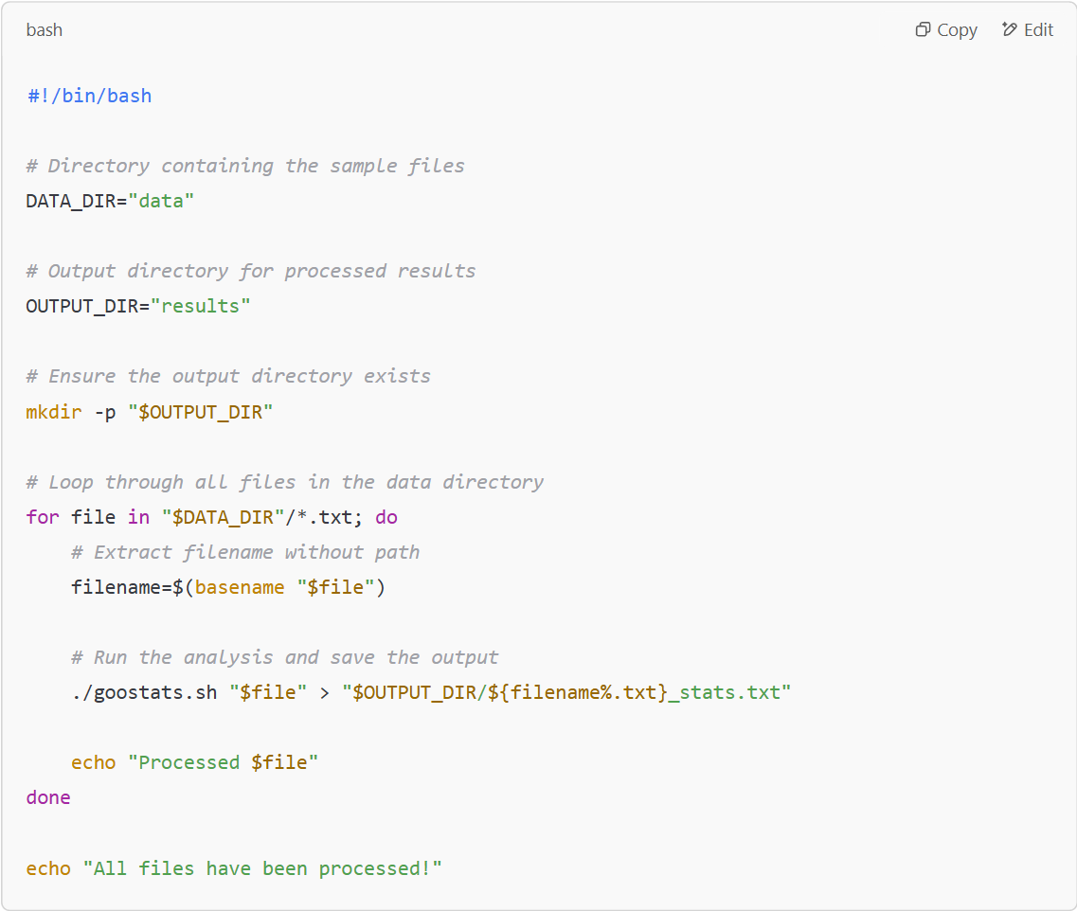
Story 1: Solution

Slide 87
Explanation
Defines Directories:
DATA_DIR contains the 1520 input files.
OUTPUT_DIR stores the processed results.
The script ensures that the output directory exists (mkdir -p "$OUTPUT_DIR").
Loops Over All Files:
It finds all .txt files in DATA_DIR.
Extracts the filename using basename.
Runs goostats.sh on Each File:
The output is saved with _stats.txt suffix in OUTPUT_DIR.
Displays Progress Messages:
echo "Processed $file" informs the user of progress.
Once all files are processed, a completion message is printed.

Slide 88
How to Use
Save this script as process_samples.sh.
Give it execute permission: chmod +x process_samples.sh
Run it: ./process_samples.sh
This script will allow Nelle to focus on her paper while the computer processes her data!

Slide 89
Story 2: An Insurance Company

Slide 90
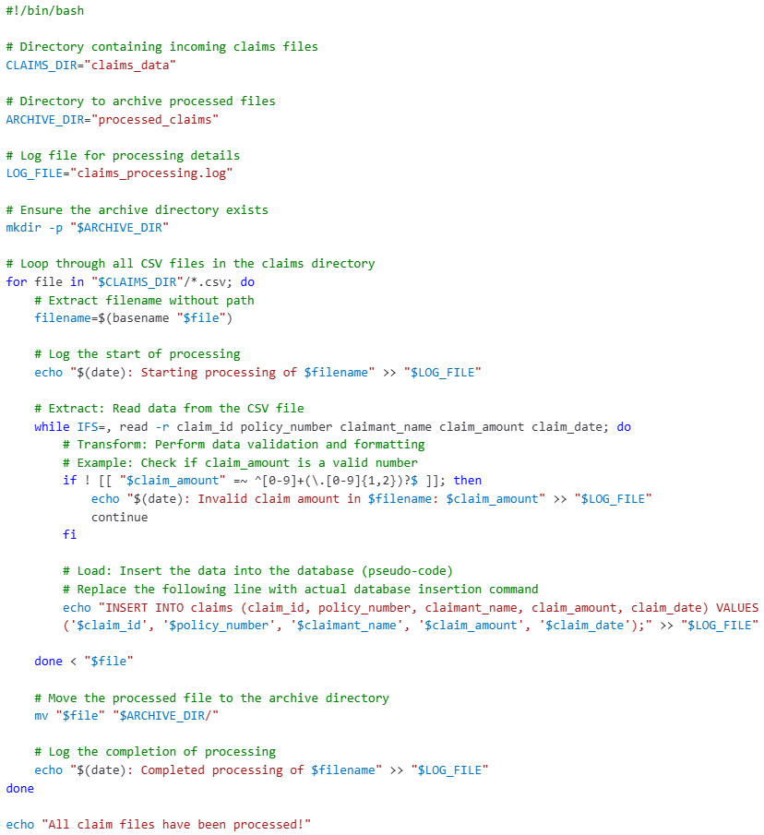
Story 2: Solution

Slide 91
Explanation
Directories:
CLAIMS_DIR: Contains the incoming claims CSV files.
ARCHIVE_DIR: Stores the processed files for record-keeping.
Log File:
LOG_FILE: Records processing activities and any issues encountered.
Processing Loop:
The script iterates through each CSV file in the CLAIMS_DIR.
For each file, it reads the data line by line.
Data Validation: Checks if the claim_amount is a valid number.
Data Loading: Inserts the validated data into the database. (Note: The actual database insertion command should replace the placeholder echo statement.)
After processing, the file is moved to the ARCHIVE_DIR.

Slide 92
How to Use
Save the Script: Save the script as process_claims.sh.
Make it Executable: Run chmod +x process_claims.sh to make the script executable.
Execute the Script: Run ./process_claims.sh to start processing the claims files.

Slide 93

Practice Coding – A LOT

Slide 94


